Slide 1

Congestion Control in Computer Networks
Kevin Comba

Slide 2

What is Congestion?
Congestion in a computer network happens when there is too much data being sent at the same time, causing the network to slow down.
Just like traffic congestion on a busy road, network congestion leads to delays and sometimes data loss. When the network can’t handle all the incoming data, it gets “clogged,” making it difficult for information to travel smoothly from one place to another.

Slide 3
Effects of Congestion Control in Computer Network
Improved Network Stability: Congestion control helps keep the network stable by preventing it from getting overloaded
Reduced Latency and Packet Loss: Without congestion control, data transmission can slow down, causing delays and data loss. Congestion control helps manage traffic better, reducing these delays and ensuring fewer data packets are lost, making data transfer faster and the network more responsive.
Enhanced Throughput: By avoiding congestion, the network can use its resources more effectively. This means more data can be sent in a shorter time, which is important for handling large amounts of data and supporting high-speed applications.
Fairness in Resource Allocation: Congestion control ensures that network resources are shared fairly among users. No single user or application can take up all the bandwidth, allowing everyone to have a fair share.
Better User Experience: When data flows smoothly and quickly, users have a better experience. Websites, online services, and applications work more reliably and without annoying delays.
Mitigation of Network Congestion Collapse: Without congestion control, a sudden spike in data traffic can overwhelm the network, causing severe congestion and making it almost unusable. Congestion control helps prevent this by managing traffic efficiently and avoiding such critical breakdowns.

Slide 4

Congestion Control Algorithms
Congestion Control is a mechanism that controls the entry of data packets into the network, enabling a better use of a shared network infrastructure and avoiding congestive collapse.
Congestive-avoidance algorithms (CAA) are implemented at the TCP layer as the mechanism to avoid congestive collapse in a network.
There are two congestion control algorithms which are as follows:
Leaky Bucket Algorithm
Token Bucket Algorithm

Slide 5
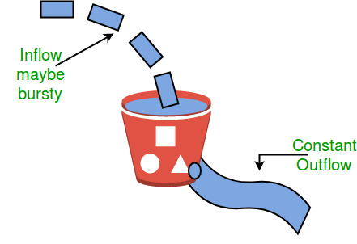
Leaky Bucket Algorithm
This algorithm is used to control the rate at which traffic is sent to the network and shape the burst traffic to a steady traffic stream.
The leaky bucket algorithm discovers its use in the context of network traffic shaping or rate-limiting.
Main disadvantage with the leaky-bucket algorithm is the inefficient to use of available network resources. Ie large area network resources such as bandwidth is not being used effectively.
Let us consider an example to understand Imagine a bucket with a small hole in the bottom. No matter at what rate water enters the bucket, the outflow is at constant rate.
When the bucket is full with water additional water entering spills over the sides and is lost.

Slide 6
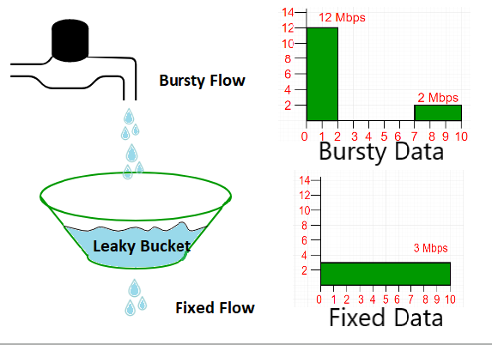
Leaky Bucket Algorithm in details
Suppose we have a bucket in which we are pouring water at random points in time but we have to get water at a fixed rate to achieve this we will make a hole at the bottom of the bucket. This will ensure that the water coming out is at some fixed rate. If the bucket gets full, then we will stop pouring water into it.
The input rate can vary but the output rate remains constant. Similarly, in networking, a technique called leaky bucket can smooth out bursty traffic. Bursty chunks are stored in the bucket and sent out at an average rate.
In the above figure, we assume that the network has committed a bandwidth of 3 Mbps for a host. The use of the leaky bucket shapes the input traffic to make it conform to this commitment. In the above figure, the host sends a burst of data at a rate of 12 Mbps for 2s, for a total of 24 Mbits of data. The host is silent for 5 s and then sends data at a rate of 2 Mbps for 3 s, for a total of 6 Mbits of data. In all, the host has sent 30 Mbits of data in 10 s. The leaky bucket smooths out the traffic by sending out data at a rate of 3 Mbps during the same 10 s.

Slide 7
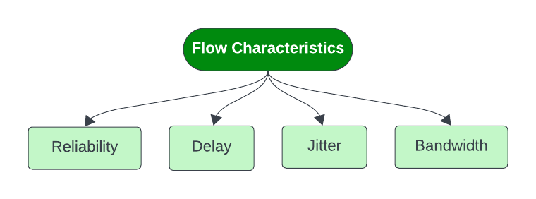
Token Bucket Algorithm
The Token Bucket algorithm is a popular and simple method used in computer networking and telecommunications for traffic shaping and rate limiting. It is designed to control the amount of data that a system can send or receive in some sort of period, ensuring that the traffic conforms to a specified rate.
It refers to traffic control mechanisms that seek to either differentiate performance based on application or network-operator requirements or provide predictable or guaranteed performance to applications, sessions, or traffic aggregates. It is something that data flow seeks to attain.
Flow Characteristics of Token Bucket Algorithm
Four types of characteristics are attributed to a flow:
Reliability
Delay
Jitter
Bandwidth

Slide 8
Token Bucket Algorithm
Characteristics of Token Bucket Algorithm
Reliability
It implies packet reached or not, information lost or not. Lack of reliability means losing a packet or acknowledgement, which entails re-transmission. Reliability requirements may differ from program to program. For example, it is more important that electronic mail, file transfer and internet access have reliable transmissions than telephony or audio conferencing.
Delay
It denotes source-to-destination delay. Different applications can tolerate delay in different degrees. Telephony, audio conferencing, video conferencing, and remote log-in need minimum delay, while delay in file transfer or e-mail is less important.
Jitter
Jitter is the variation in delay for packets belonging in same flow. High jitter means the difference between delays is large; low jitter means the variation is small. For example, if packets 0,1,2,3s arrive at 6,7,8,9s it represents same delay. Jitter would signify that packets departed at 0,1,2,3s reach destination at 4,6,10,15s. Audio and video applications don't allow jitter.
Bandwidth
Different applications need different bandwidths. In video conferencing we need to send millions of bits per second to refresh a color screen while the total number of bits in an e-mail may not reach even a million.

Slide 9
Need for Token Bucket Algorithm
Video and audio conferencing require a bounded delay and loss rate.
Video and audio streaming requires a bounded packet loss rate, it may not be so sensitive to delay.
a -critical applications (real-time control) in which bounded delay is considered to be an important factor.
Valuable applications should provide better services than less valuable applications.

Slide 10
Disadvantages of Token Bucket Algorithm
Token Bucket has the tendency to generate tokens at a fixed rate, even when the network traffic is not present. This is leads of accumulation of unused tokens during times when there is no traffic, hence leading to wastage.
Due to token accumulation, delays can be introduced in the packet delivery. If the token bucket happens to be empty, packets will have to wait for new tokens, leading to increased latency and potential packet loss.
Token Bucket happens to be less flexible than Leaky Bucket when it comes to network traffic shaping. The fixed token generation rate cannot be easily altered to meet changing network requirements, unlike the adaptable nature of leaky bucket.
The implementation involved in token bucket can be more complex, especially due to the fact that different token generation rates are used for different traffic types. Configuration and management might be more difficult due to this.
Usage of large bursts of data may lead to inefficient use of bandwidth and may cause congestion. Leaky bucket algorithm, on the other hand helps prevent congestion by limiting the amount of data sent at any given time, promoting more efficient bandwidth utilization.

Slide 11
Difference between Leaky and Token buckets
Leaky Bucket | Token Bucket
When the host has to send a packet , packet is thrown in bucket. | In this, the bucket holds tokens generated at regular intervals of time.
Bucket leaks at constant rate | Bucket has maximum capacity.
Bursty traffic is converted into uniform traffic by leaky bucket. | If there is a ready packet , a token is removed from Bucket and packet is send.
In practice bucket is a finite queue outputs at finite rate | If there is no token in the bucket, then the packet cannot be sent.

Slide 12
Advantages of Congestion Control
Stable Network Operation: Congestion control ensures that networks remain stable and operational by preventing them from becoming overloaded with too much data traffic.
Reduced Delays: It minimizes delays in data transmission by managing traffic flow effectively, ensuring that data packets reach their destinations promptly.
Less Data Loss: By regulating the amount of data in the network at any given time, congestion control reduces the likelihood of data packets being lost or discarded.
Optimal Resource Utilization: It helps networks use their resources efficiently, allowing for better throughput and ensuring that users can access data and services without interruptions.
Scalability: Congestion control mechanisms are scalable, allowing networks to handle increasing volumes of data traffic as they grow without compromising performance.
Adaptability: Modern congestion control algorithms can adapt to changing network conditions, ensuring optimal performance even in dynamic and unpredictable environments.

Slide 13
Disadvantages of Congestion Control
Complexity: Implementing congestion control algorithms can add complexity to network management, requiring sophisticated systems and configurations.
Overhead: Some congestion control techniques introduce additional overhead, which can consume network resources and affect overall performance.
Algorithm Sensitivity: The effectiveness of congestion control algorithms can be sensitive to network conditions and configurations, requiring fine-tuning for optimal performance.
Resource Allocation Issues: Fairness in resource allocation, while a benefit, can also pose challenges when trying to prioritize critical applications over less essential ones.
Dependency on Network Infrastructure: Congestion control relies on the underlying network infrastructure and may be less effective in environments with outdated or unreliable equipment.

Slide 14
Conclusion
Congestion control is essential for keeping computer networks running smoothly. It helps prevent network overloads by managing the flow of data, ensuring that information gets where it needs to go without delays or loss. Effective congestion control improves network performance and reliability, making sure that users have a stable and efficient connection. By using these techniques, networks can handle high traffic volumes and continue to operate effectively.

